Slide 1
Compliance Techniques
Foot in the door
Large compliance is more likely after a small one
Door in the face
Compliance is more likely after a rejection
Low balling
Compliance more likely if costs are revealed after securing an agreement
That’s not all!
Compliance more likely if apparent value is elevated
Notes:
The ultimate goal of missionary work is to get people reading the BoM, coming to church, getting baptized, and paying tithing. In a sense, they are basically “selling” their theology, and anything they do to elicit compliance is considered good work, even if it is devious and manipulative. Many of the tricks employed by door-to-door salesmen are readily employed by LDS missionaries.

Slide 2
Low Balling
“Extra credit” work for a class. One hour of work.
Oh by the way, it is at 7am on a Wednesday.
Cost/commitment
24 % (7/29)
Commitment/cost
53 % (18/34)
Cialdani, R. B., Basset, R., Cacioppo, J. T., Miller, J. A., “Low-ball procedure for producing compliance: commitment then cost,” Journal of Personality and Social Psychology, 36, 5 (1978).
Notes:
Low balling is an especially dirty trick that comes to mind. Call some freshman students over the phone and offer them course credit for taking part in an experiment on “thinking processes.” Tell them that they need to come in at 7am on a Weekday (yikes!). Or, first wait for a “yes” and then tell them it will be at 7am.

Slide 3
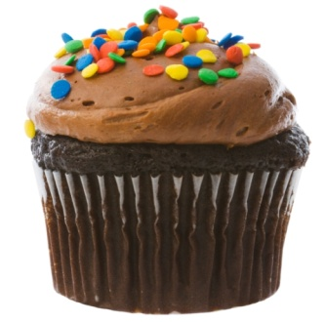
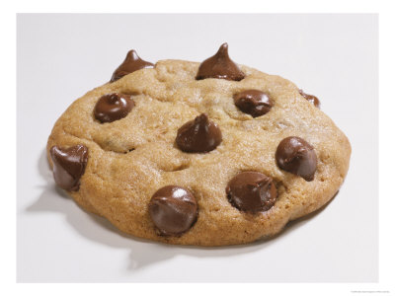
That’s Not All!
Bake sale offer on pastries.
One cupcake and two cookies for $0.75.
40 % compliance.
One cupcake for $0.75.
“No, wait…”
One cupcake and two cookies for $0.75.
75 % compliance!
x1
x2
Burger, J. M., “Increasing compliance by improving the deal: the that’s-not-all technique”, Journal of Personality and Social Psychology, 51, 2 (1986).
Notes:
Subjects in the that's-not-all (TNA; N = 30) condition were told that the cupcakes were 75C each. At this exact moment the second experimenter, who had been looking down at some papers, tapped the first experimenter on the shoulder. The first experimenter held up his or her hand and said to the customer "wait a second" without allowing the customer to respond to the price of the cupcake. After a very brief exchange between the experimenters (approximately 2-3 s), the first experimenter lowered his hand and announced to the subjects that the price included two medium-sized cookies.

Slide 4
Foot in the door
Can a survey team of 5-6 men come to your home for 2 hours and classify your household products?
What if we first ask you a few questions about soap?
Large request:
22.2 %
Small/large requests
52.8 %
Freedman, J. L., and Fraser, S. C., “Compliance without pressure: the foot-in-the-door technique,” Journal of Personality and Social Psychology, 4, 2 (1966).
Notes:
Call people over the phone and tell them you are part of a consumer study organization (“California Consumers Group”). Ask if a team of 5-6 men can come to your house and rummage through your stuff so as to catalogue your household consumption (large request). Or, first get them to answer a few benign questions about soap usage (small request) before brining up the large request.
Take home points: People are freakishly easy to manipulate into compliance. Compliance can then be used to generate cognitive dissonance. Cognitive dissonance can be used to generate sincere internal beliefs.

Slide 5
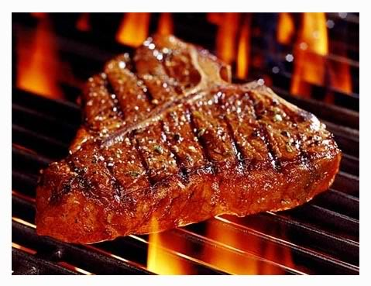
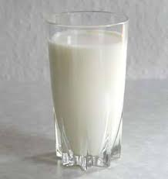
Applications to Religion
People are suckers ☹
“Milk before the meat” doctrine = foot-in-the-door effect.
Notes:
Think about the doctrine of the “milk before the meat.” It is easier to accept more outlandish requests when you have already acquiesced to smaller intrusions.
John, do you maybe have any examples or similar sales tactics designed to generate compliance and exposure to converts?
I knew a girl once (roommate of my girlfriend at the time) who invited her non-LDS friend over for dinner with the missionaries. She knew full well that the missionaries were going to try and proselytize to this person, but almost certainly did not tell her that beforehand. If the friend knew, she may have likely declined the invitation. However, once you are committed to the evening, it is “rude” to get up and leave for the stuff you don’t like, even if you would have refused it anyway.

Slide 6
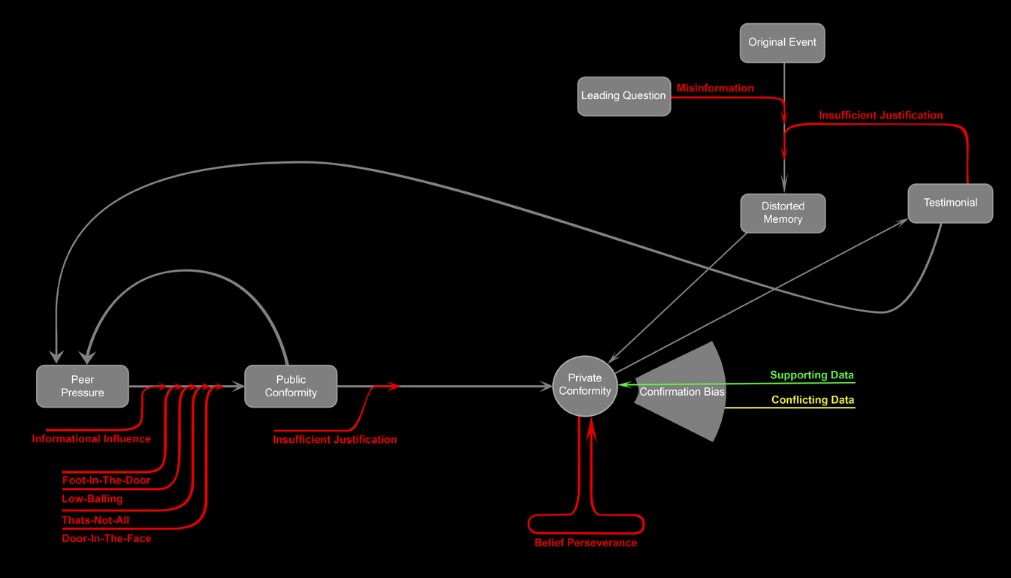
Overview
Notes:
Me and my brother started thinking a lot about these various techniques and their interrelationships with each other. So we started playing around with a flowchart to see if we could visualize the process better. This is what we came up with for the current stage our progress per the discussion. I freely admit that this is hardly a rigorous scientific chart, but it does make a few key points. First, it is kind of funny to watch it grow messier and more convoluted with each new study. Secondly, it powerfully emphasizes the staggering array of psychological mechanisms by which ideas can be generated out of pure imagination and then implanted into the human brain. Remember that each arrow has been empirically demonstrated in peer-reviewed experiments, and that each arrow is statistically reliable in its power to skew human beliefs.

Slide 7
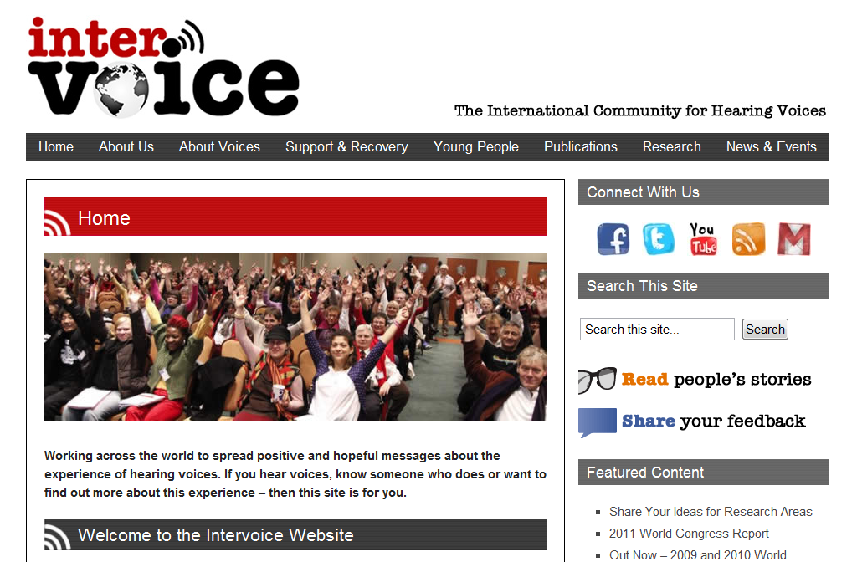
Hallucinations
www.intervoiceonline.org
Notes:
Often times people will claim to “feel the spirit” or personally witness to the “voice of God.” These can be very powerful testimonies because they represent an apparently direct contact with the divine. But how special is this really? How reliable are such experiences? Why do some people have them more often than others? Is it possible that God really does “speak” with his children this way?
These questions nagged at me until I heard an interview on some radio talk show (don’t even remember which one exactly). The woman was a literal “voice hearer” who started hearing voices when her life went through some emotionally difficult times. She made the comment that such experiences are actually fairly common. This really struck me and motivated me to do some research. There are actually whole support groups online and around the world where people talk about this stuff and share their experiences. Anywhere from 2-5% of the population experiences regular auditory hallucinations in the form of voices. HOW COOL IS THAT? :D

Slide 8
Voice Triggers
Head trauma
Bereavement
Drug abuse
Sexual abuse
Solitary confinement
Childhood neglect
Bipolar disorder
Migraines
Schizophrenia
Social anxiety
Multiple personality disorder
PTST
Sleep deprivation
… and many more!
Notes:
The following is a list of documented triggers that statistically lead to auditory hallucinations in the form of voices. This list only took me perhaps 1-2 hours of digging around in the scientific journals. I could probably even double it if I tried hard enough. There is nothing special whatsoever about hearing voices. It is perfectly normal. I have even personally experienced this myself during the transition from awake into sleep. It literally feels like a voice in your mind is talking outside of your own conscious control.
Another key finding is that such hallucinations are relatively common. There is nothing crazy or “coo coo” about a person that experiences some form of verbal hallucinations. They happen all the time to nearly everyone. Most of the time they are harmless or virtually undetectable and go unnoticed. Other times they can be pleasant or uplifting. Occasionally they can be severe and debilitating.

Slide 9
The “Still Small Voice”
Moritz, S. and Laroi, F., “Differences and similarities in the sensory and cognitive signatures of voice-hearing, intrusions and thoughts,” Schizophrenia Research, 102, 1 (2008).
Notes:
One very interesting study compared the relative properties of voice hallucinations among various subjects. Interestingly, the vast majority of voices are relatively quiet. Other voices are not really “voices” at all, but feel instead like urges and thoughts that are beyond the control of the subject. The authors even dubbed these experiences as “intrusions.” This reminds me a great deal about the “still small voice” that Mormons are so passionately fond of.
Other parameters studied were relative control that people have over their voices and relative conformity between the voices’ personalities and the personality of the subjects. People experience a huge variance in all of these features, including healthy, normal individuals.
What does it mean when there exists a natural phenomenon that practically replicates all of the symptoms of a personal religious revelation?

Slide 10
Hallucination or No?
Can other people hear your same voice?
Is the information consistent?
Does the voice say anything useful?
Predict earthquakes?
Reveal profound, inhuman wisdom?
Can your voice manifest itself physically?
Move objects?
Make your pets dance?
Notes:
The ultimate problem with reliance on things like “the divine witness of the holy spirit” is that such things are completely indistinguishable from the natural background of hallucinatory noise that we all experience. Religious believers from all faiths will claim divine manifestations in this form, yet still cannot seem to converge on a single version of theology. So unless your voice can perform something tangibly meaningful, there is no reason to prefer one form of apparent hallucination over the other. They are all equivalent.
The sad thing is, demonstration of divine power should be a piece of cake. Here are just a few examples of simple demonstrations that would all be very compelling evidence of a truly spiritual phenomenon.

Slide 11
Take Home Points
Auditory/visual hallucination is perfectly normal.
Voices come in a wide variety of volumes, personalities, intrusiveness, and apparent conscious control.
Psychological intrusions seem to replicate the “still small voice” of the Holy Ghost.
Spiritual communication carries the same qualities as the natural background noise in human perception.
Notes:
Which is more likely? That God preferred form of personal revelation is indistinguishable from random hallucinatory noise? Or that all the apparent manifestations of “the spirit” (or whatever) are simply part of that very same noise?
Take home point: Unless your voice can produce information that is completely outside of your own perception (ie, see through walls, predict the future, prove Fermat’s last theorem in less than 2 pages, manifest in multiple people, and do so under controlled conditions), then your voice is almost certainly a natural auditory hallucination.

Slide 12
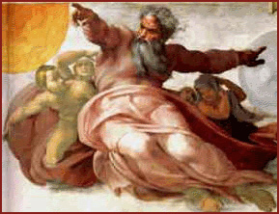
God of the Gaps
*POOF*
Point out a gap in our current scientific understanding of the universe and fill it with God.
Cosmological argument
Teleological argument
Argument from morality
What makes these arguments so compelling?
Notes:
We have a name for this. It is called an “argument from ignorance.”

Slide 13
Meet Bob
Bob
(1) Smart
(2) Artistic
(3) Sentimental
(4) Cool
(5) Awkward
(6) Faultfinding
Favorability score = 1.38
Anderson, N. H. and Barrios, A. A., “Primacy effects in personality impression formation,” Journal of Abnormal and Social Psychology, 63, 2 (1961).
Notes:
I want you to form an impression of a stranger. You will do so based entirely on a set of six adjectives. Consider these adjectives as if they were taken from six close friends of Bob. Rate Bob on a scale of [-5,5] (unfavorable, favorable). Give this experiment to a dozen or so subjects and you’ll probably get a score between 1 and 2.

Slide 14
Meet Carl
(1) Faultfinding
(2) Awkward
(3) Cool
(4) Sentimental
(5) Artistic
(6) Smart
Carl
Favorability score = -0.72
Primacy = 2.10
Notes:
Now repeat the experiment again, but reverse the order of the words. All of a sudden, subjects will tend to rate Bob negatively. Why?
The words were deliberately engineered to flow in a specific order from favorable to unfavorable traits (and then vice versa). However, people tend to be influenced more by the information that come FIRST and less by the information that comes later. This biases the favorability response towards the initial words. The difference in response between orders is called the PRIMACY: 1.38 – (-0.72) = 2.10.

Slide 15
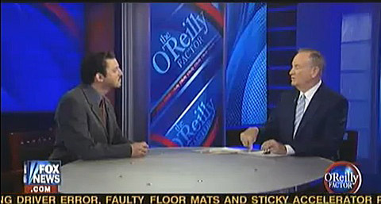
Need for Cognitive Closure
The desire for an answer on a given topic, any answer, as compared to confusion and ambiguity.
“Tide goes in, tide goes out… You can’t explain that.” – Bill O’Reilly
Notes:
How does the existence of tides suddenly prove the existence of God? Or the moon? Or the universe? How does our failure to render a scientific answer to some given phenomenon automatically lead us to the conclusion that a magical sky-fairy just poofed it all into existence?
Another interview has Bill saying, “You can’t explain how it all got here.”
This is called an argument from existence. The logic is excruciatingly lame, yet people are hugely compelled by it. WHY?

Slide 16
Need for Closure Scale
Example ratings:
“I think that having clear rules and order at work is essential for success.”
“I don't like situations that are uncertain.”
“When dining out, I like to go to places where I have been before so that I know what to expect.”
“When considering most conflict situations, I can usually see how both sides could be right.”
Neuberg, S. L., Judice, N. T., and West, S. G., “What the need for closure scale measures and what it does not: toward differentiating among related epistemic motives ,” Journal of Personality and Social Psychology, 72, 6 (1997).
Notes:
Interestingly, need for cognitive closure is an actual personality trait that some people exhibit more than others. All you do is rate yourself on a series of questions. The net result is a number that reflects your overall need for closure and represents “the desire for an answer on a given topic, any answer, as compared to confusion and ambiguity.”

Slide 17
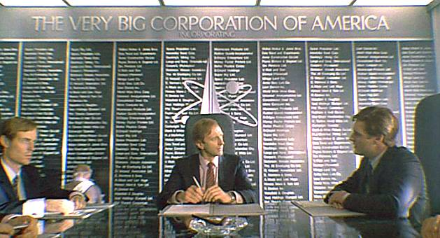
Meet Phil
Imagine you are the hiring manager for a major firm. Your job is the determine the potential success/failure of an important new employee.
Webster, D. M. and Kruglanski, A. W., “Individual Differences in Need for Cognitive Closure,” Journal of Personality and Social Psychology, 67, 6 (1994).
Notes:
There are a whole bunch of papers on the subject of NFCC, primacy, intolerance of ambiguity, etc. This paper simply shows a nice demonstration of the link between NFCC and primacy, which is relevant to our discussion.

Slide 18
Employee Evaluation
Separate subjects by scores on NFCC scale
(1) High NFCC
(2) Low NFCC
Present subjects with audio recordings of candidate’s performance
Positive - Negative
Negative - Positive

Slide 19
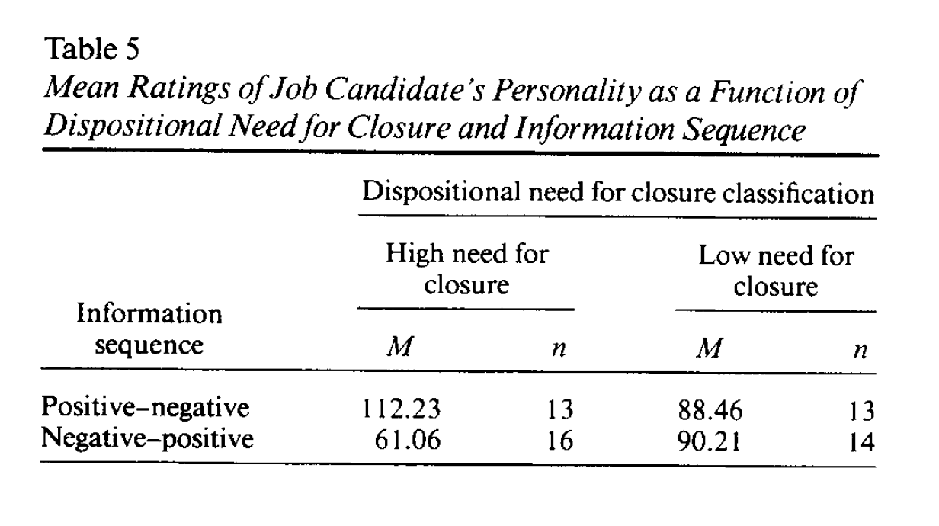
Results
NFCC scores have a strong correlation with primacy effects
Strong Primacy
Weak Primacy
Notes:
People with low NFCC are virtually immune to primacy effects.

Slide 20
NFCC and Religiosity
Some studies even suggest a link between high NFCC and religiosity/fundamentalism.
Brant, M. and Reyna, C., “The role of prejudice and the need for closure in religious fundamentalism,” Personality and Social Psychology Bulletin, 36, 5 (2010).
Saroglou, V., “Beyond dogmatism: the need for closure as related to religion,” Mental Health, Religion and Culture, 5, 2 (2002).
Notes:
Just a quick slide. NFCC seems to have a link with religiosity and fundamentalism. At least two papers have confirmed this connection. It is not dramatically strong, but it does seem to positively correlate.

Slide 21
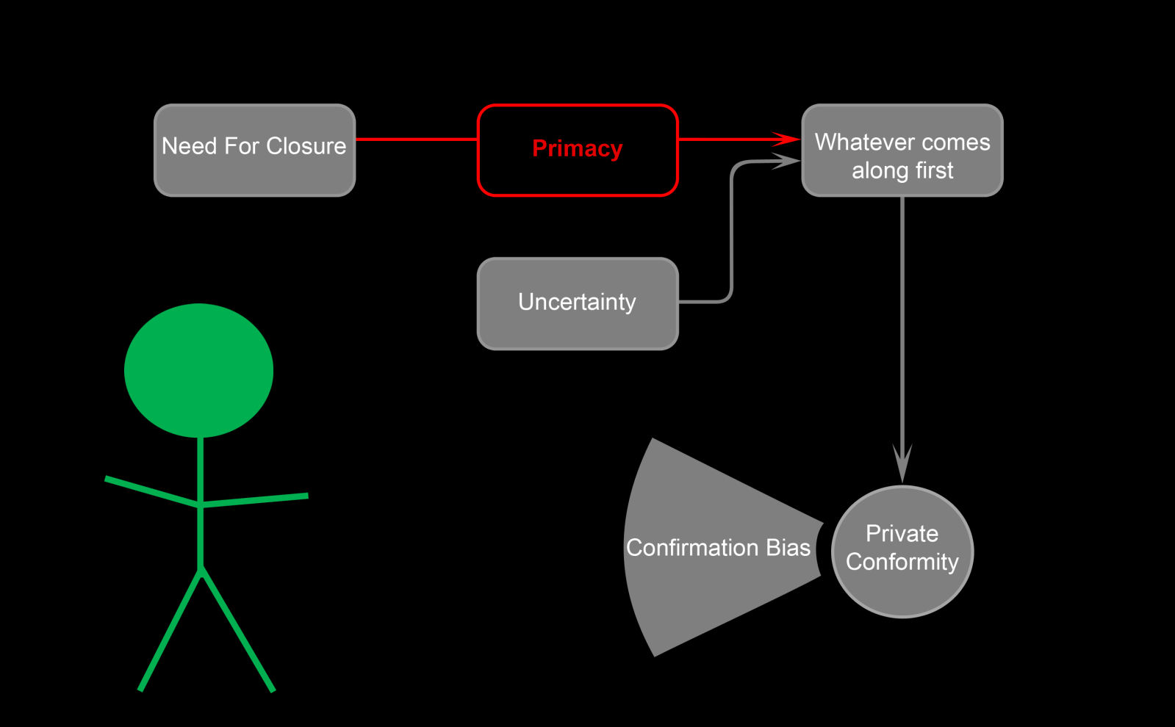
God of the Gaps Explained
Why arguments from ignorance work so well.
Notes:
“You can’t explain how it all got here!” – Bill O’Rilley while interviewing Richard Dawkins.
This is why “God of the Gaps” reasoning is so prolific, even though it is nothing more than a pure argument from ignorance.
People with high NFCC cannot stand ambiguity or uncertainty. They therefore latch on to whatever answer happens to come along first. “God did it” is such a common answer to everything we do not know, people cannot help but latch on to it when seeking answers to deep questions. Once an answer is embedded in our heads, confirmation bias and belief perseverance take over.

Slide 22
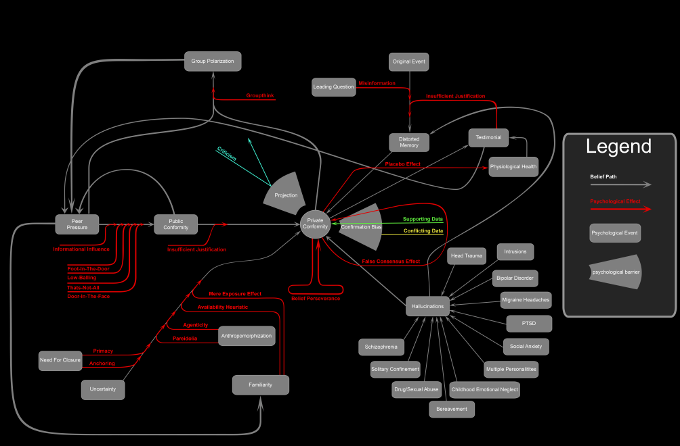
Tip of the Iceberg
Notes:
There are a gajillion different cognitive biases out there, and we could easily spend days going over all the various studies. Hopefully, the point is clear by now. We human beings seriously SUCK at exercising rational thought. Our memories and our perceptions are readily distorted. Social pressure jerks us around in all sorts of ways. We’re hopeless suckers against clever salesmen. But worst of all, the Church (and religion in general) tries to work WITHIN our hopeless biases rather than around them. What does this say about the nature of religion and the Church? What does this say about science and scientific method?

